Slide 1
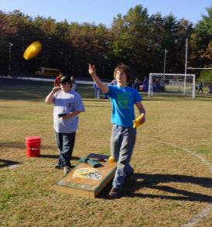
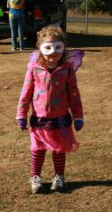
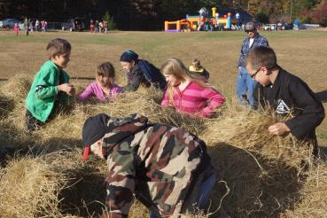
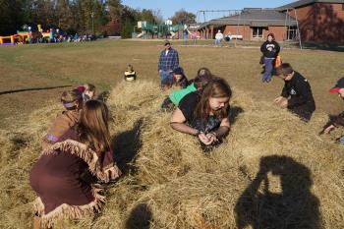
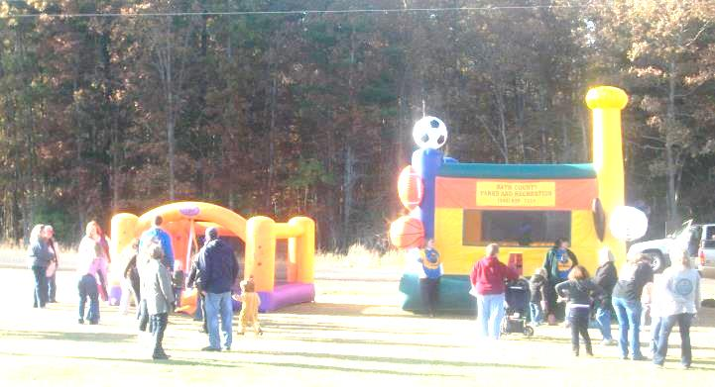
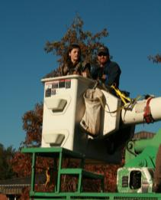
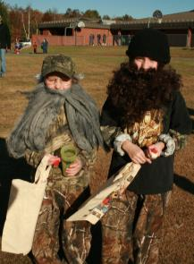
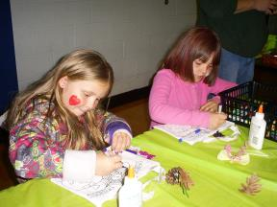
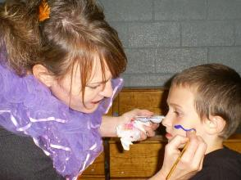
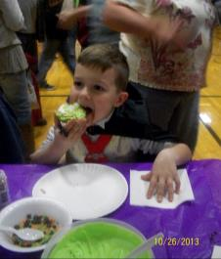
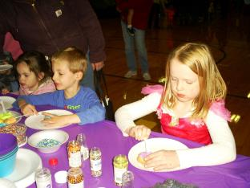
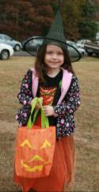
On Saturday, October 26th, Millboro Elementary celebrated their Second Annual Fall Festival. The families in the community celebrated with lots of fun activities including a Trunk or Treat, Bouncy Houses, Needle in the Haystack, Pumpkin Bowling, Nature Crafts, Cookie Decorating, Carnival Games along with lots of prizes, a Cake Walk, etc. BARC Electric provided rides in a bucket truck, Millboro Masonic Lodge offered Child ID Kits, Joe McLain offered Caricatures, and lots more. It was great to have the support of businesses, churches and community groups in Bath County. Thank you to everyone from all of us at Millboro Elementary School.

